Slide 1
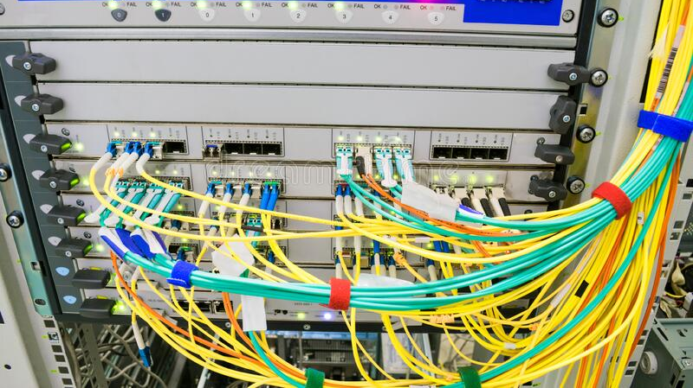
BGP Security Vitaly Shmatikov

Slide 2
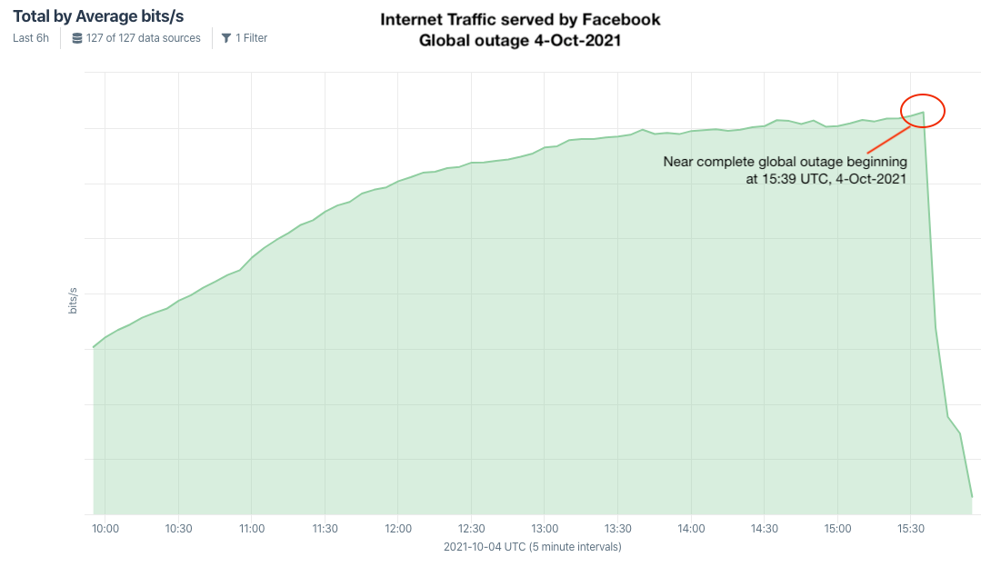
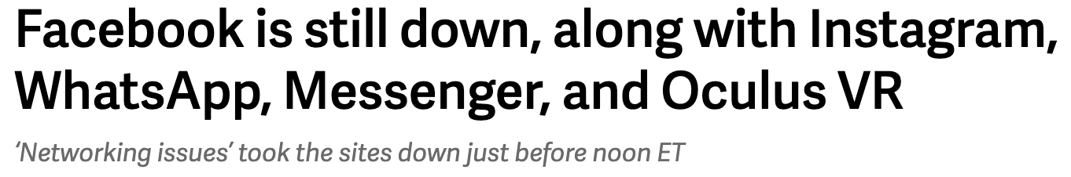
Remember Last Week?
… someone at Facebook caused an update to be made to the company’s Border Gateway Protocol (BGP) records
https://krebsonsecurity.com/2021/10/what-happened-to-facebook-instagram-whatsapp/

Slide 3
IP Routing
Routing of IP packets is based on IP addresses
32-bit host identifiers (128-bit in IPv6)
Routers use a forwarding table
Entry = destination, next hop, network interface, metric
Table look-up for each packet to decide how to route it
Routers learn routes to hosts and networks via routing protocols
Host is identified by IP address, network by IP prefix
BGP (Border Gateway Protocol) is the core Internet protocol for establishing inter-AS routes

Slide 4
Distance-Vector Routing
Each node keeps vector with distances to all nodes
Periodically sends distance vector to all neighbors
Neighbors send their distance vectors, too; node updates its vector based on received information
Bellman-Ford algorithm: for each destination, router picks the neighbor advertising the cheapest route, adds his entry into its own routing table and re-advertises
Used in RIP (routing information protocol)
Split-horizon update
Do not advertise a route on an interface from which you learned the route in the first place!

Slide 5
Good News Travels Fast
A: 0
A: 1
A: 2
A: 3
A: 4
A: 5
1
1
1
1
1
G1
G2
G3
G4
G5
G1 advertises route to network A with distance 1
G2-G5 quickly learn the good news and install the routes to A via G1 in their local routing tables

Slide 6
Bad News Travels Slowly
Split-horizon update only prevent two-node loops
Exchange
routing tables
A: 0
A: 1
A: 2
A: 3
A: 4
A: 5
1
1
1
1
G1
G2
G3
G4
G5
G1’s link to A goes down
G2 is advertising a pretty good route to G1 (cost=2)
G1’s packets to A are forever looping between G2 and G1
G1 is now advertising a route to A with cost=3, so G2 updates its own route to A via G1 to have cost=4, and so on… slowly counting to infinity

Slide 7
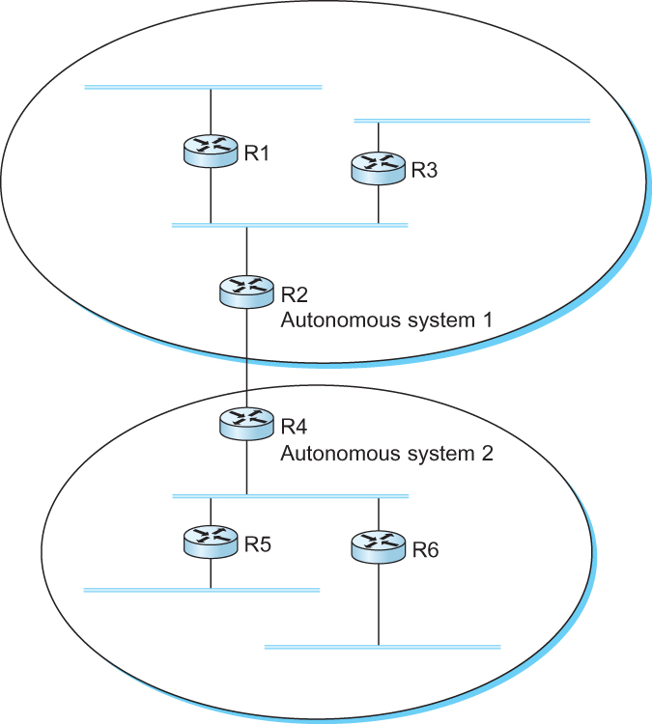
Interdomain Routing
Internet is organized as autonomous systems (AS), each under the control of a single administrative entity
Autonomous System (AS) corresponds to an administrative domain
Examples: university network, corporate internal network, backbone network, network of a single Internet service provider

Slide 8
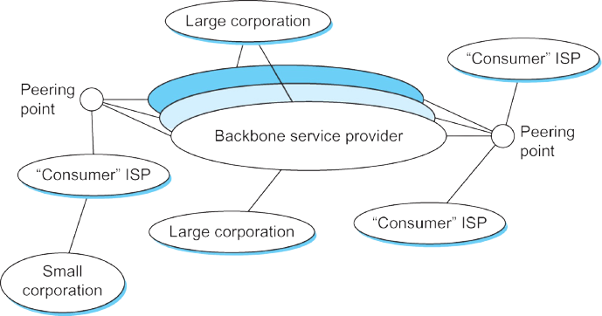
Simple Model of Global Internet
Often many providers arrange to interconnect with each other at a single “peering point”
Many service providers exist mainly to provide service to “consumers” (individuals with computers and devices), and these providers must connect to the backbone providers
Some large corporations connect directly to one or more of the backbones, while others connect to smaller, non-backbone service providers

Slide 9
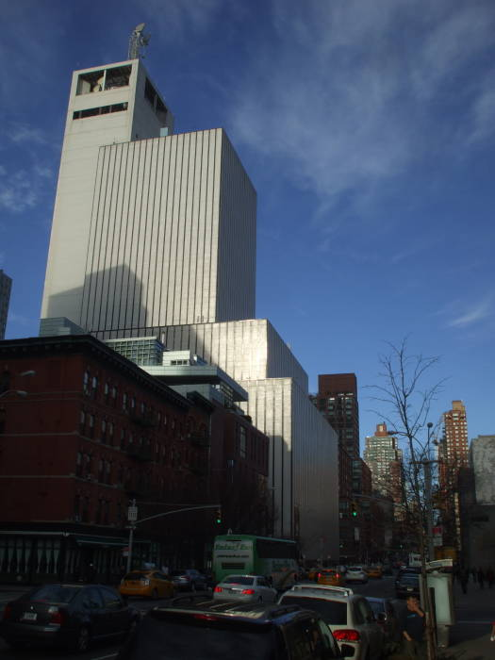

A Little Side Note About Peering Points
ATT peering facility
811 10th Avenue

Slide 10

https://www.dailydot.com/debug/nsa-spy-prgrams-prism-fairview-blarney/

Slide 11
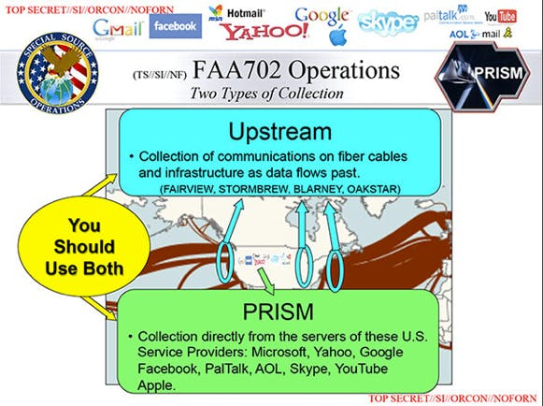
https://www.dailydot.com/debug/nsa-spy-prgrams-prism-fairview-blarney/

Slide 12
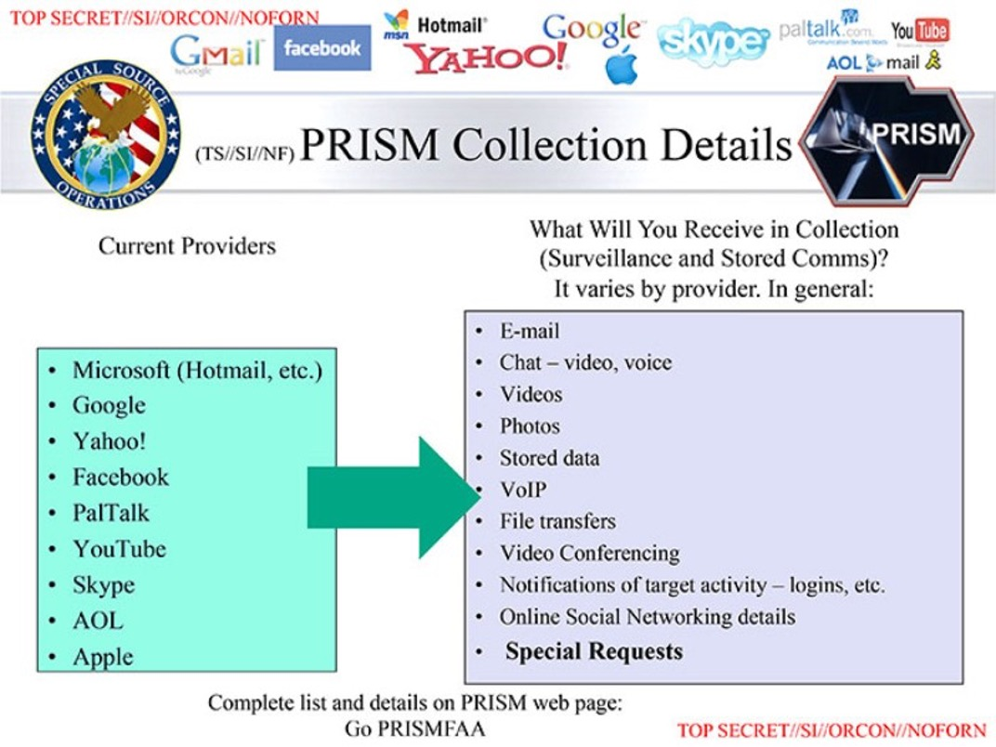
https://www.dailydot.com/debug/nsa-spy-prgrams-prism-fairview-blarney/

Slide 13
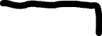
Goals of BGP
The goal of Inter-domain routing is to find any path to the intended destination that is loop-free
Reachability rather than optimality!
Finding a path anywhere close to optimal is considered a great achievement (why?)

Slide 14
BGP Challenges
Scalability: a backbone router must be able to forward any packet to anywhere in the Internet
Routing table must have a match for any valid IP address
Full autonomy of the domains
Impossible to calculate meaningful cost for a path that crosses multiple ASs
A cost of 1000 might imply a great path from one provider and unacceptably bad from another provider
Providers may not trust each other
Providers may not believe each other’s route advertisements

Slide 15
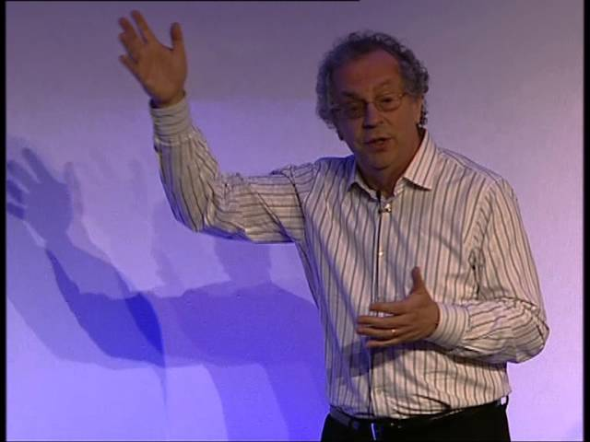
Overview of BGP
BGP is a path-vector protocol between ASes
Just like distance-vector, but routing updates contain an actual path to destination node, ie, the list of traversed ASes and the set of network prefixes belonging to the first AS on the list
Each BGP router receives update messages from neighbors, selects one “best” path for each prefix, and advertises this path to its neighbors
Can be the shortest path, but doesn’t have to be (“hot potato” vs. “cold potato”)
Always route to the most specific prefix for a destination
Yakov Rekhter

Slide 16
BGP Example
1
3
3 2 7
4
2 7
2 6 5
2 6 5
3 2 6 5
5
8
2
2 7
6 5
7 2 6 5
7
2 7
7
6
6 2 7
5
7
2 6 5
5
AS 2 provides transit for AS 7
Traffic to and from AS 7 travels through AS 2
Source: David Wetherall

Slide 17
Some (Old) BGP Statistics
BGP routing tables contain about 125,000 address prefixes mapping to about 17-18,000 paths
Approx. 10,000 BGP routers
Approx. 2,000 organizations own AS
Approx. 6,000 organizations own prefixes
Average route length is about 3.7
50% of routes have length less than 4 ASes
95% of routes have length less than 5 ASes

Slide 18
BGP Illustration
Slide: Michael Schapira
$
$
Verizon
peer
Init 7 AG
Zurich
UPC
peer
IP Prefix
$
43284
provider
$
customer
20984
$
Slide: Michael Schapira

Slide 19
Routing with BGP
Slide: Michael Schapira
UPC, Prefix
UPC, Prefix
Verizon
Init 7 AG
Zurich
UPC
IP Prefix
Init 7, UPC, Prefix
$
$
43284
Verizon, UPC, Prefix
20984
43284, Init 7, UPC, Prefix
Prefer revenue generating routes
Prefer shorter routes
Slide: Michael Schapira

Slide 20
Routing with BGP
Slide: Michael Schapira
UPC, Prefix
UPC, Prefix
Verizon
Init 7 AG
Zurich
UPC
IP Prefix
Init 7, UPC, Prefix
$
$
43284
Verizon, UPC, Prefix
20984
43284, Init 7, UPC, Prefix
Prefer revenue generating routes
Prefer shorter routes
Do not carry transit traffic for free
X
Losing $$
20984,Verizon, UPC, Prefix

Slide 21
BGP Issues
Convergence problems
Protocol allows policy flexibility
Some legal policies prevent convergence
Even shortest-path policy converges slowly
Incentive for dishonesty
ISP pays for some routes, others free
Security problems
Potential for disruptive attacks

Slide 22
Evidence: Asymmetric Routes
Alice
Bob
Cheapest does not always mean the shortest!
Alice, Bob use cheapest routes to each other
Asymmetic routes are prevalent
AS asymmetry in 30% of measured routes
Finer-grained asymmetry far more prevalent

Slide 23
BGP Misconfiguration (Route Leak)
Domain advertises good routes to addresses it does not know how to reach
Result: packets go into a network “black hole”
April 25, 1997: AS7007 (Florida Internet Exchange) de-aggregated the BGP route table and re-advertised all prefixes as if it originated paths to them
In effect, AS7007 was advertising that it has the best route to every host on the Internet
Huge network instability as incorrect routing data propagated and routers crashed under traffic

Slide 24

http://www.securerouting.net/incident/20/
https://dyn.com/blog/routing-leak-briefly-takes-google/

Slide 25

BGP Has No Security Model
BGP update messages contain no authentication or integrity protection
Anyone can advertise any route
Change the AS path
Either attract traffic to attacker’s AS, or divert traffic away
Interesting economic incentive: an ISP wants to dump its traffic on other ISPs without routing their traffic in exchange
Hijack IP addresses
AS announces it originates a prefix it shouldn’t
AS announces it has shorter path to a prefix
AS announces more specific prefix

Slide 26
In-Class Exercise
What attacks / problems could result from BGP insecurity?

Slide 27
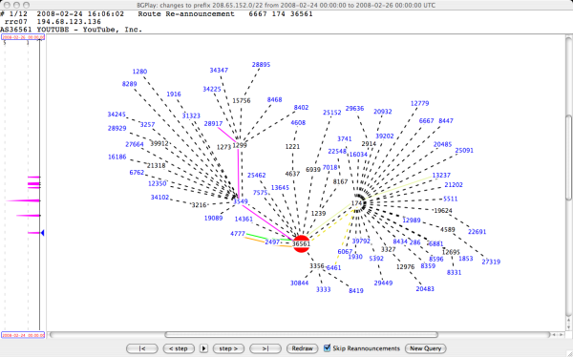

YouTube (Normally)
AS36561 (YouTube) advertises 208.65.152.0/22

Slide 28
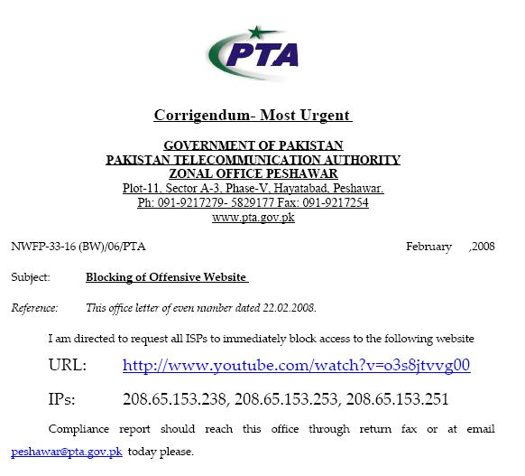

February 24, 2008
Pakistan government wants to block YouTube

Slide 29
What Should’ve Happened
Slide: Michael Schapira
drop packets
Pakistan
Telecom
X
YouTube
I’m YouTube:
IP 208.65.153.0/22
Multinet
Pakistan
Telnor
Pakistan
Aga Khan
University

Slide 30
What Did Happen
Slide: Michael Schapira
More specific than the /22 prefix advertised by YouTube itself
No, I’m YouTube!
IP 208.65.153.0/24
Pakistan
Telecom
Pakistan
Telecom
YouTube
I’m YouTube:
IP 208.65.153.0/22
Multinet
Pakistan
Telnor
Pakistan
Aga Khan
University

Slide 31
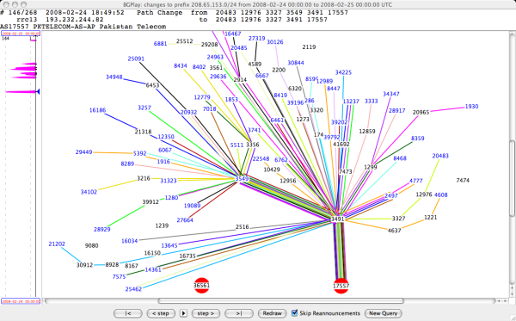
Two-Hour YouTube Outage

Slide 32
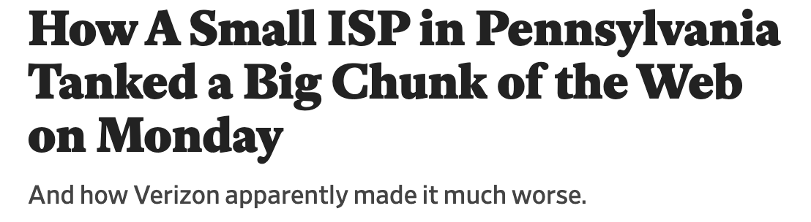
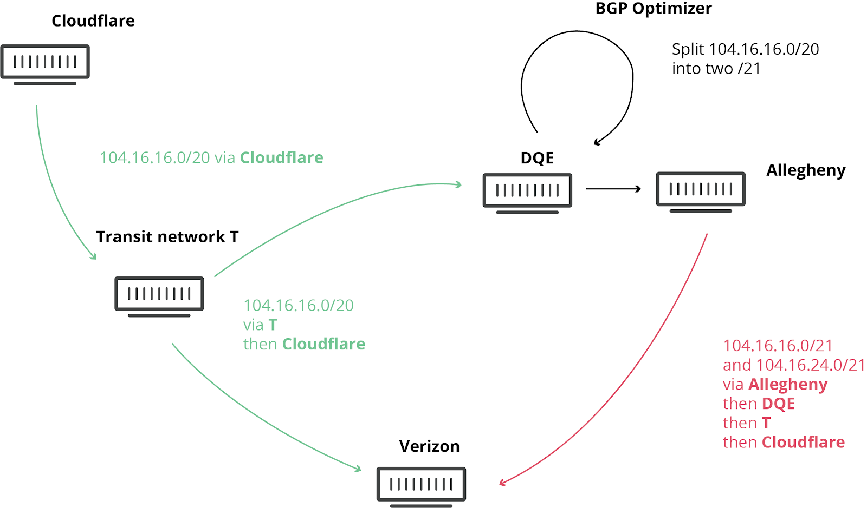
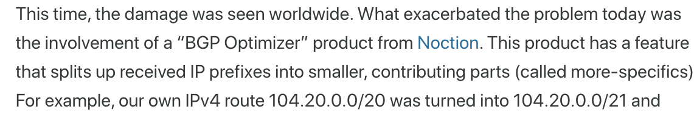
June 2019
DQE Communications advertised (“originated”) route to 2400 networks
Tiny ISP serving 2000 buildings in Pittsburgh
Verizon propagated these routes
Result: multi-hour outage at Cloudflare (approx. 1.5 million websites), AWS, Reddit, Overcast, Discord, Twitch…
https://slate.com/technology/2019/06/verizon-dqe-outage-internet-cloudflare-reddit-aws.html
https://blog.cloudflare.com/how-verizon-and-a-bgp-optimizer-knocked-large-parts-of-the-internet-offline-today/

Slide 33
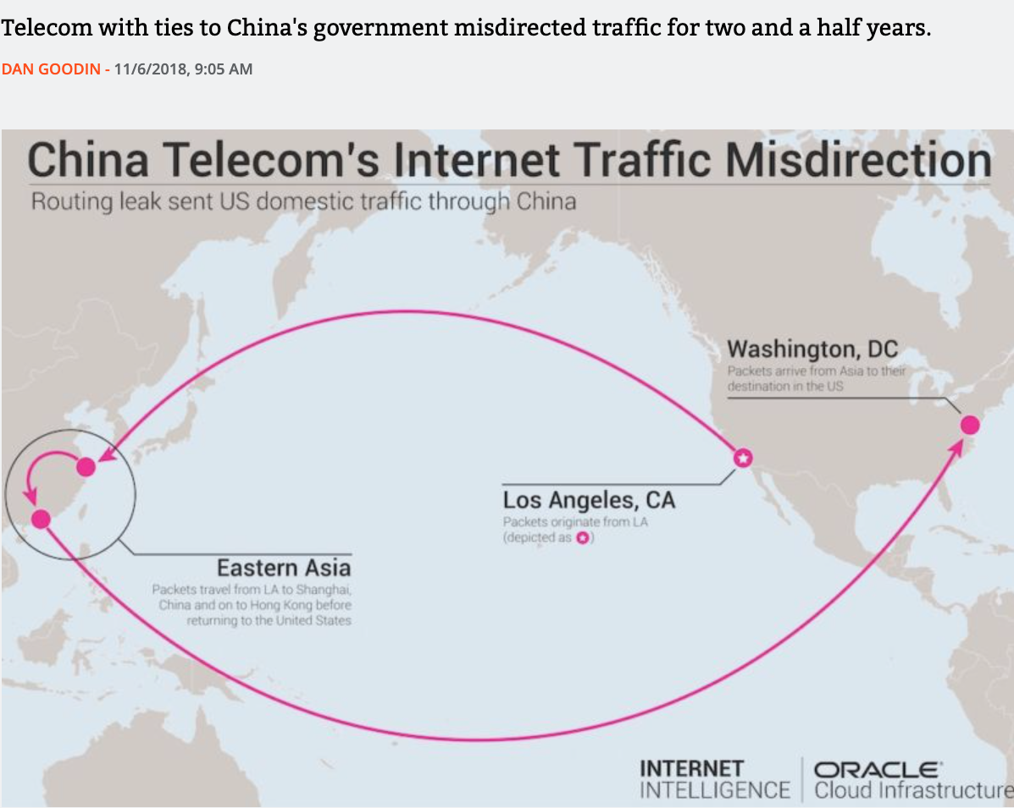
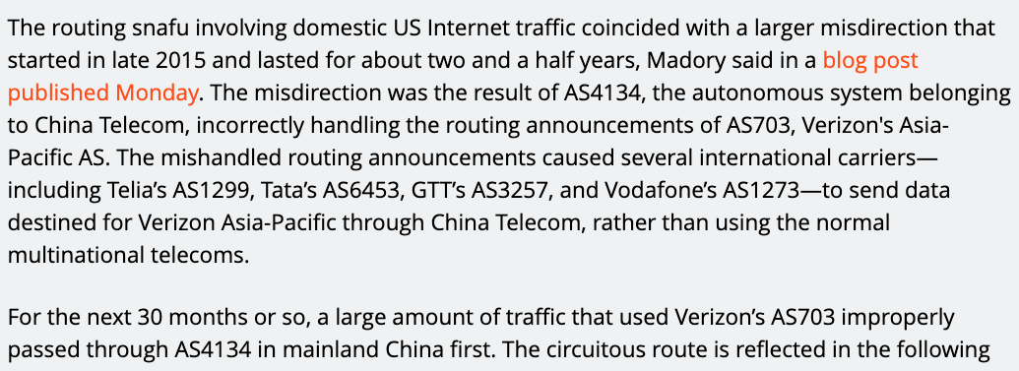
China Telecom Incidents
https://arstechnica.com/information-technology/2018/11/strange-snafu-misroutes-domestic-us-internet-traffic-through-china-telecom/

Slide 34
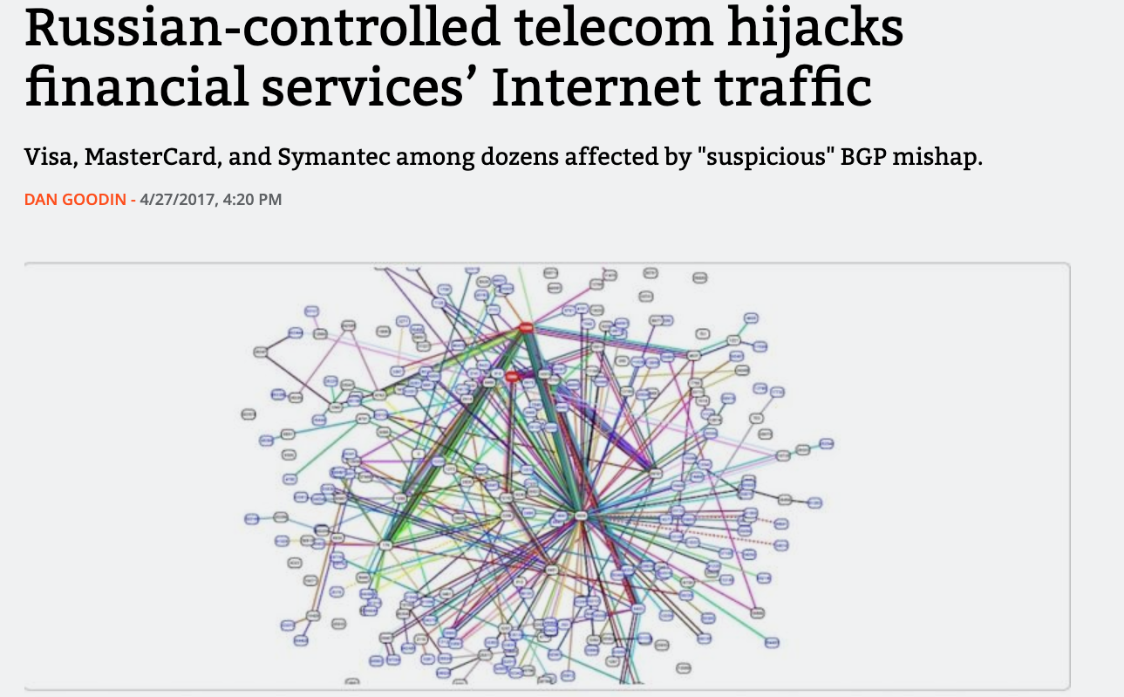
Rostelecom Incident
36 networks affected,
incl. Symantec, EMC,
many banks

Slide 35

IP Address Ownership and Hijacking
IP address block assignment
Regional Internet Registries (ARIN, RIPE, APNIC)
Internet Service Providers
Proper origination of a prefix into BGP
By the AS who owns the prefix
However, what’s to stop someone else?
Prefix hijacking: another AS originates the prefix
BGP does not verify that the AS is authorized
Registries of prefix ownership are inaccurate
… or, by its upstream provider(s) in its behalf

Slide 36
Hijacking is Hard to Debug
The victim AS doesn’t see the problem
Picks its own route
Might not even learn the bogus route
May not cause loss of connectivity
E.g., if the bogus AS snoops and redirects
… may only cause performance degradation
Or, loss of connectivity is isolated
E.g., only for sources in parts of the Internet
Diagnosing prefix hijacking
Analyzing updates from many vantage points
Launching traceroute from many vantage points

Slide 37
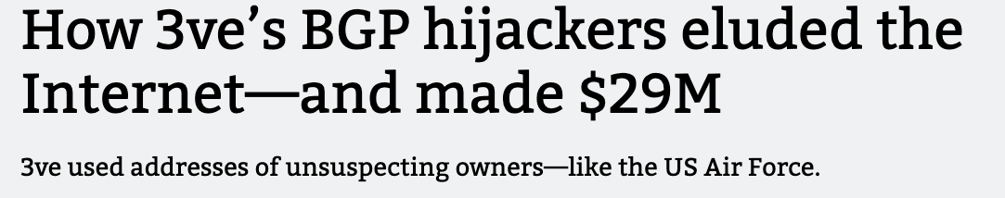
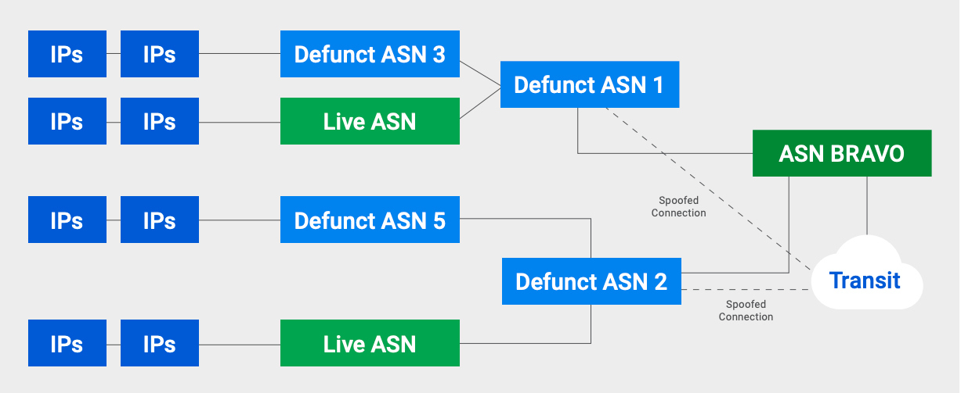
Eastern European cybercriminals set up several legitimate-looking ISPs + defunct ISPs to advertise routes to unused IP addresses
Later started impersonating legitimate ISPs
1 million compromised IP addresses
IP addresses used for ad fraud: host fake sites impersonating premium websites, send bots to “view” ads on these websites
700K bots / compromised Windows machines
3B+ daily ad bid requests
https://arstechnica.com/information-technology/2018/12/how-3ves-bgp-hijackers-eluded-the-internet-and-made-29m/

Slide 38
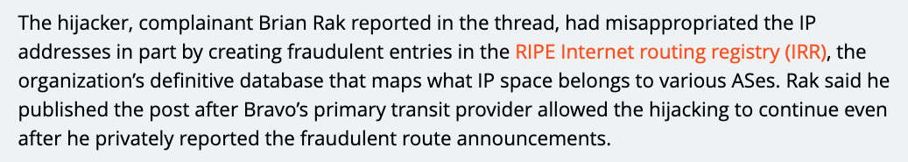
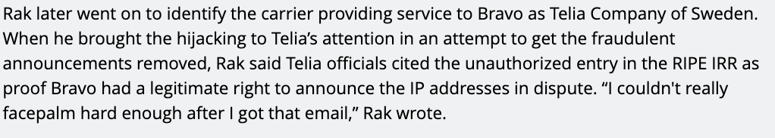
Who Can Advertise Routes?
IRR (Internet Route Registry) system records which AS can originate/announce which routes… but
https://arstechnica.com/information-technology/2018/12/how-3ves-bgp-hijackers-eluded-the-internet-and-made-29m/

Slide 39
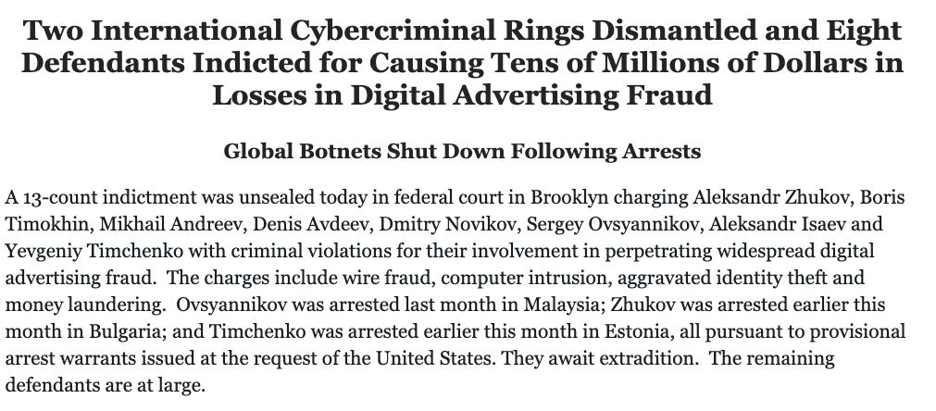

Slide 40
In-Class Exercise
How would you prevent IP hijacking?

Slide 41
Preventing Prefix Hijacking
Origin authorization
Secure database lists which AS owns which IP prefix
soBGP
Digitally signed certificates of prefix ownership
Prefix hijacking is not the only threat… in general, BGP allows ASes to advertise bogus paths
Remove another AS from a path to make it look shorter, more attractive, get paid for routing traffic
Add another AS to a path to trigger loop detection, make your connectivity look better

Slide 42

Bogus AS Paths
Remove an AS from the path
Add an AS to the path
For example, advertise 701 88 for this path
Possible motivations:
Make AS path look shorter than it is
Attract sources that try to avoid 3715
For example, advertise 701 3715 88 for this path
Possible motivations:
Trigger loop detection in AS 3715
Make your AS look like is has richer connectivity
701
3715
88
701
88

Slide 43
RPKI
IRR (Internet Route Registry) system records which AS can originate/announce which routes
Unauthenticated, contains invalid data
RPKI cryptographically signs ROA (“Route Origin Authorization”) records
Verifies that an owner of IP address block authorized a particular AS to originate routes to those addresses
Who has the authority to sign these records?
TAs (“trust anchors”): currently RIRs (Regional Internet Registries)
Somewhat similar to Web certificates
https://blog.cloudflare.com/rpki/

Slide 44
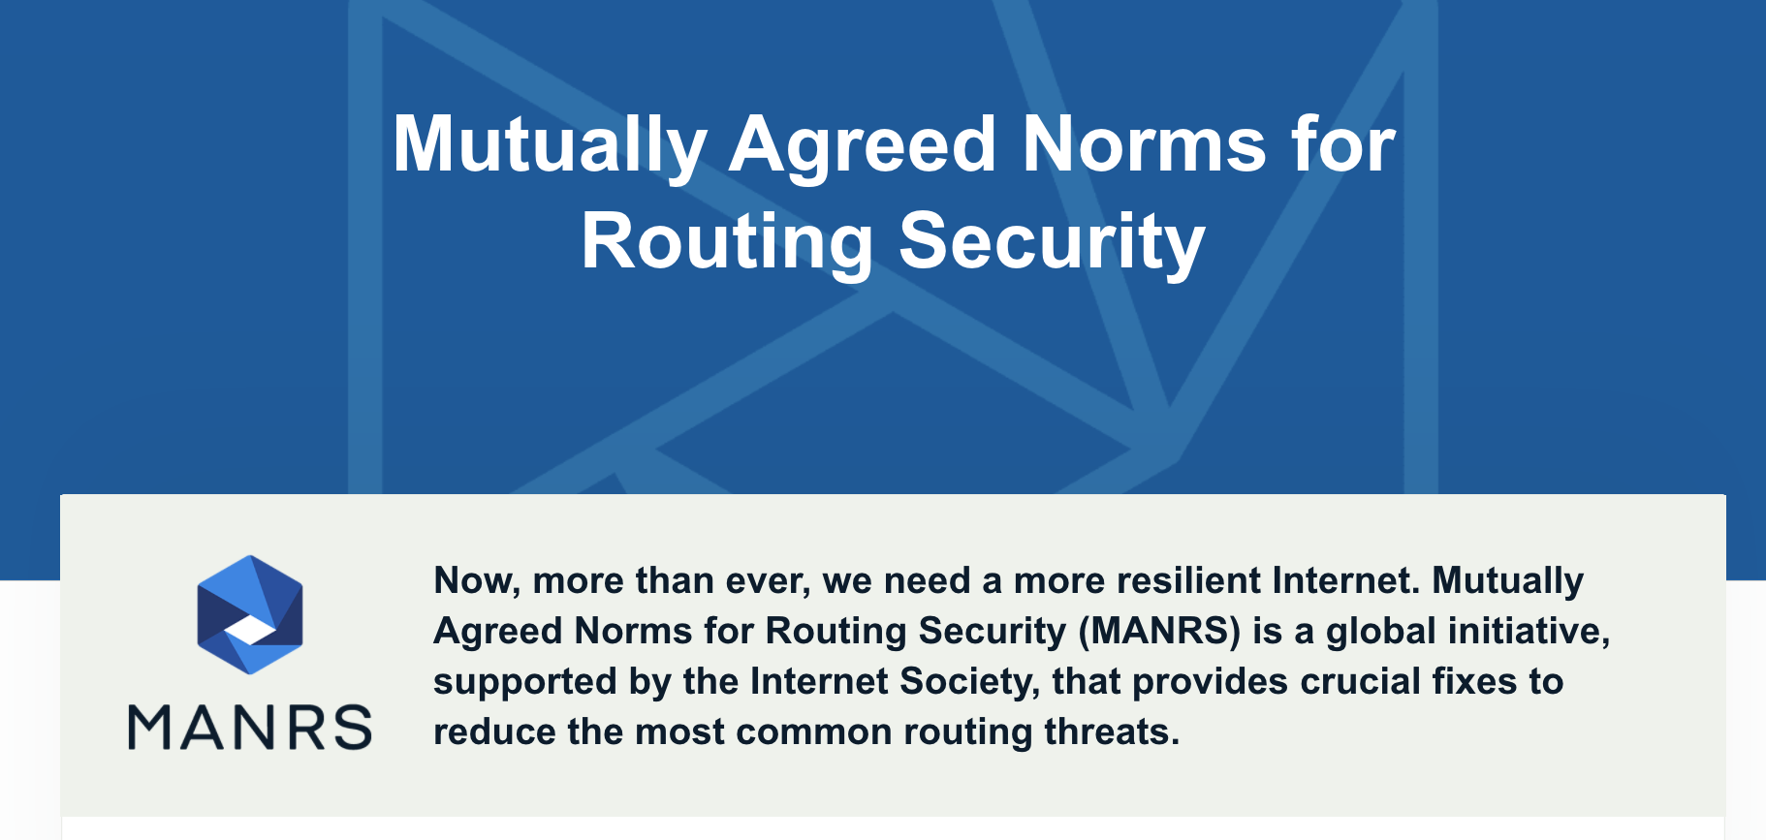

Slide 45
Protecting BGP
Simple authentication of packet sources and packet integrity is not enough
Before AS advertises a set of IP addresses, the owner of these addresses must authorize it
Goal: verify path origin
Each AS along the path must be authorized by the preceding AS to advertise the prefixes contained in the UPDATE message
Goal: verify propagation of the path vector

Slide 46
S-BGP Protocol
Address attestation
Owner of one or more prefixes certifies that the origin AS is authorized to advertise the prefixes
Need a public-key infrastructure (PKI)
X.509 certificates prove prefix ownership; owner can then delegate his “prefix advertising rights” to his ISP
Route attestation
Router belonging to an AS certifies (using digital signatures) that the next AS is authorized to propagate this route advertisement to its neighbors
Need a separate public-key infrastructure
Certificates prove that AS owns a particular router
Kent, Lynn, Seo

Slide 47
S-BGP Update Message
An update message from R₉ advertising this route must contain:
Ownership certificate certifying that some X owns IP address S₁
Signed statement from X that AS₁ is authorized to advertise S₁
Ownership certificate certifying that AS₁ owns router R₆
If AS is represented by a router
Signed statement from R₆ that AS₂ is authorized to propagate AS₁’s routes
Ownership certificate certifying that AS₂ owns router R₉
Lots of public-key operations!
S₁
S₂
S₃
S₄
S₅
R₆
R₇
R₈
AS₁
R₉
R₁₀
AS₂
R₁₂

Slide 48
Securing BGP
Dozens of proposals, various combinations of cryptographic protocols and anomaly detection
Example: Secure BGP (S-BGP)
Origin authentication + entire AS path digitally signed
Can verify that the route is recent, no ASes have been added or removed, the order of ASes is correct
Also: IRV, SPV, psBGP, PGBGP, PHAS, Whisper…
How many of these have been deployed?
None
- No complete, accurate registry of prefix ownership
- Need a public-key infrastructure
- Cannot react rapidly to changes in connectivity
- Cost of cryptographic operations
- Not deployable incrementally

